Slide 1
Predicting COVID Deaths Using ML
Isabella Zhu and Lilian Zhu
Yilmaz Period 5

Slide 2
Introduction

Slide 3
Project Goal
To predict if a COVID patient will die from COVID using data such as their state/county of residence, age group, etc.
3
Notes:
Lilian

Slide 4
Dataset
Source: https://data.cdc.gov/Case-Surveillance/COVID-19-Case-Surveillance-Public-Use-Data-with-Ge/n8mc-b4w4
This dataset is from the CDC and contains COVID case surveillance data.
Each instance is a COVID case.
19 attributes (less than 20, but this was approved)
82,313,422 instances
death_yn is the class attribute
4
Notes:
Lilian

Slide 5
Dataset Attributes
case_month: the earlier of month the Clinical Date (date related to the illness or specimen collection) or the date received by CDC
res_state: state of residence
state_fips_code: state FIPS code
res_county: county of residence
county_fips_code: county FIPS code
age_group: age group (0-17 years, 18-49 years, 50-64 years, 65+ years)
sex: female, male, other
race: American Indian/Alaska Native, Asian, Black, Multiple/Other, Native Hawaiian/Other Pacific Islander, White
ethnicity: Hispanic, Non-Hispanic
case-positive_specimen_interval: weeks between earliest date and date of first positive specimen collection
5
Notes:
Lilian

Slide 6
Dataset Attributes
case_onset_interval: weeks between earliest date and date of symptom onset
process: the process in which the case was first identified (clinical evaluation, routine surveillance, contact tracing, multiple, other)
exposure_yn: did the patient have any known exposures, such as travel, work, etc.
current_status: current status of person (lab-confirmed case, probable case)
symptom_status: symptom status of person (asymptomatic, symptomatic, unknown)
hosp_yn: was the patient hospitalized?
icu_yn: was the patient admitted to an intensive care unit?
underlying_conditions_yn: did the patient have underlying conditions?
death_yn: did the patient die? (CLASS LABEL)
6
Notes:
Lilian

Slide 7
Pre-Processing

Slide 8
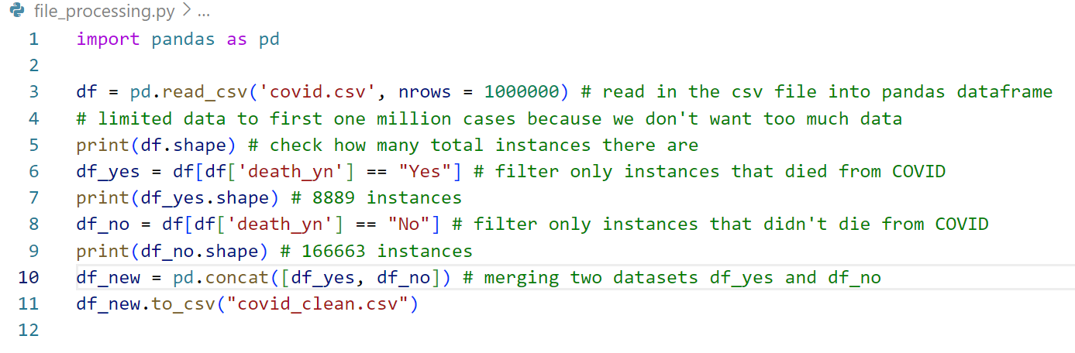
Missing Values Handling
used Python’s Pandas DataFrame
removed all instances with missing class label
Notes:
Isabella

Slide 9
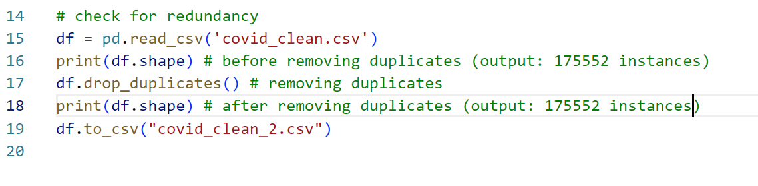
Redundancy
also used Python’s Pandas DataFrame
check for duplicate rows
Notes:
Isabella

Slide 10
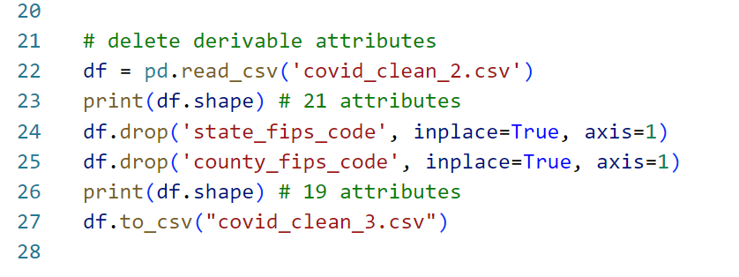
Removing Derivable Attributes
attributes state_fips_code and county_fips_code are derivable from state_res and county_res, respectively
these attributes provide no extra information
Notes:
Isabella

Slide 11
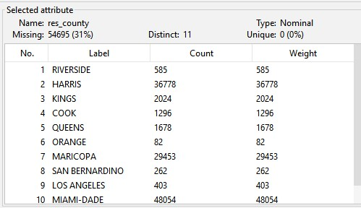
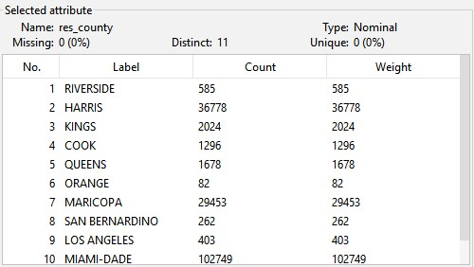
WEKA Processing
converted .csv file to .arff file in WEKA’s ARFF-Viewer window
ran dataset through WEKA’s ReplaceMissingValues filter
11
Notes:
Lilian

Slide 12
Model Algorithms

Slide 13
Attribute Selection Algorithms
CFS Subset Evaluation (BestFirst)
Attributes: res_county, age_group, hosp_yn, icu_yn
Correlation Attribute Evaluation (Ranker)
Attributes: icu_yn, hosp_yn, age_group, res_county, sex
Information Gain Attribute Evaluator (Ranker)
Attributes: res_state, res_county, hosp_yn, age_group
Gain Ratio Attribute Evaluation (Ranker)
Attributes: icu_yn, hosp_yn
Intuition
Attributes: icu_yn, hosp_yn, age_group, exposure_yn, underlying_conditions_yn
We used a cutoff of 0.1 (excluding CFS Subset).
Notes:
Isabella

Slide 14
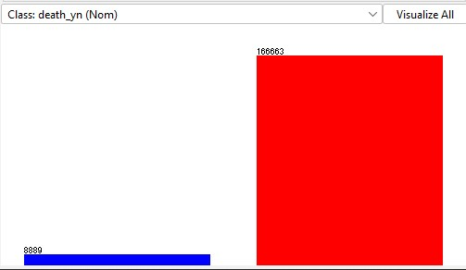
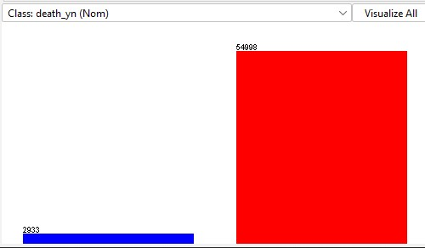
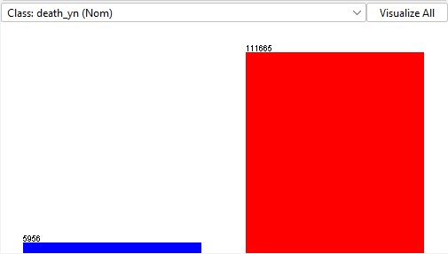
Training/Testing
done in WEKA
split training/testing for each attribute selection algorithm
stratified sampling for representative sample
67:33 training to testing ratio
Before split: death to living ratio is 8869/166663 = 0.05321517073
Testing: death to living ratio is 2933/54998 = 0.05332921197
Training: death to living ratio is 5956/111665 = 0.05333810952
14
Notes:
Lilian

Slide 15
Classifier Algorithms
Naive Bayes (bayes -> NaiveBayes)
Naive Bayes creates models based on each attribute’s correlation to the class attribute (in this case, how strongly each attribute correlates with patient deaths)
J48 (trees -> J48)
J48 creates a model based on a decision tree.
OneR (rules -> OneR)
OneR creates one predictive rule for each attribute. Thus, it does not take into account combinations of attributes.
Decision Table (rules -> DecisionTable)
Similar to OneR, but there are multiple columns for different predictive rules, thus taking into account combinations of attributes.
15
Notes:
Lilian

Slide 16
Results and Analysis

Slide 17
Accuracy
 | CorrEval | InfoGain | CfsSubset | GainRatio | Intuition
Naive Bayes | 97.87% | 97.79% | 97.75% | 96.64% | 97.26%
J48 | 98.30% | 98.30% | 98.29% | 96.74% | 97.37%
OneR | 97.49% | 97.49% | 97.49% | 96.72% | 96.72%
De. Table | 98.29% | 98.29% | 98.28% | 96.73% | 97.36%
Accuracy is measured using the testing dataset
Notes:
Isabella

Slide 18
Accuracy Analysis
J48 and CorrelationAttributeEvaluator or InfoGainEvaluator produced the most accurate models at 98.30%
Trends:
Very high accuracy values throughout, within range (96%, 99%)
Expected because of skewed distribution of class labels
J48 consistently produced the best models for classification algorithm
Cfs, InfoGain, and Correlation worked the best for attribute selection
Our intuition was surprisingly better than GainRatio for attribute selection
Notes:
Isabella

Slide 19
Area Under ROC Curve
 | CorrEval | InfoGain | CfsSubset | GainRatio | Intuition
Naive Bayes | 0.9879 | 0.9858 | 0.9867 | 0.9256 | 0.9782
J48 | 0.9719 | 0.9732 | 0.9712 | 0.9255 | 0.9290
OneR | 0.815 | 0.8149 | 0.8149 | 0.6876 | 0.6876
De. Table | 0.9895 | 0.9898 | 0.9886 | 0.9258 | 0.979
19
Notes:
Lilian

Slide 20
Area Under ROC Curve Analysis
DecisionTables and InfoGain produced the best model
Area under ROC curve: 0.9898
Trends
Attribute selection
CorrelationEval, InfoGain, CfsSubset performed significantly better than GainRatio and Intuition
Classifier algorithms
OneR performed the worst by a significant amount
Other three algorithms had no significant differences.
20
Notes:
Lilian

Slide 21
Confusion Matrices
 |  | CorrEval |  | InfoGain |  | CfsSubset |  | GainRatio |  | Intuition
Naive Bayes |  | 2465 | 468 | 2324 | 609 | 2491 | 442 | 1204 | 1729 | 2101 | 832
 |  | 764 | 54234 | 672 | 54325 | 863 | 54135 | 217 | 54781 | 753 | 54245
J48 |  | 2398 | 535 | 2398 | 535 | 2368 | 565 | 1104 | 1829 | 2073 | 860
 |  | 452 | 54546 | 452 | 54546 | 426 | 54572 | 62 | 54936 | 666 | 54332
OneR |  | 1868 | 1065 | 1868 | 1065 | 1868 | 1065 | 1104 | 1829 | 1104 | 1829
 |  | 389 | 54609 | 389 | 54609 | 389 | 54609 | 69 | 54929 | 69 | 54929
De. Table |  | 2393 | 540 | 2393 | 540 | 2374 | 559 | 1104 | 1829 | 2073 | 860
 |  | 449 | 5459 | 449 | 54549 | 436 | 54562 | 63 | 54935 | 672 | 54326
Notes:
Isabella

Slide 22
Confusion Matrices Analysis
Format of confusion matrices in WEKA:
TP rate = a / (a+b)
FP rate = c / (c+d)
Best model is determined by maximizing TP rate (minimize b)
Best model is Naive Bayes and CfsSubset
87% TP rate
 | death_yn = y (predicted) | death_yn = n (predicted)
death_yn = y | a | b (false negative)
death_yn = n | c (false positive) | d
Notes:
Isabella

Slide 23
Confusion Matrices Analysis
Trends:
Classification algorithms:
OneR performed the worst (~65% TP rate)
NaiveBayes performed the best, but not significantly
Attribute selection algorithms:
Cfs, Correlation, and InfoGain produced similar results
GainRatio and our intuition performed significantly worse
Notes:
Isabella

Slide 24
Best Model
We determined our best model using TP rate
Class labels in this dataset are skewed, so accuracy is not as good of a metric.
In predicting COVID deaths, false negatives are the most dangerous
True positive rates take this into account.
ROC takes this less into account.
Accuracy and false positive does not take this into account.
Best model is Naive Bayes and CfsSubset
87% TP rate
Notes:
Isabella

Slide 25
Conclusion

Slide 26
Conclusion
Project goal: predict COVID deaths
Dataset: COVID cases from the CDC
Preprocessing:
Pandas DataFrame
WEKA
Model algorithms:
Total 20 models: 5 attribute selection algorithms, 4 classifier algorithms
Results:
Confusion matrix (true positives) more valuable than accuracy and ROC
Best model: Naive Bayes and CfsSubset
Implications:
Identify high-risk patients and allocate more care for them
Predicts COVID lethality rates based on demographics
26
Notes:
Lilian
Naive Bayes did well because the attributes were independent

Slide 27
Questions?

